Slide 1


Robotics & Electronic parts overview

Slide 2
Table of Contents
01
02
Embedded systems & Electronic parts
Introduction
03
04
Programming
Q&A Session.
01
Introduction

Slide 3
01
Introduction
we can define a robot as an artificial system that:
● has a physical body that includes actuators, sensors, and a brain.
● situated in a physical environment and eventually in a social environment including other robots and/or humans.
● exhibits a behavior performing a function.

Slide 4
01
Introduction
our workshop will focus on mobile robotics which is the most common type now a days.
● A mobile robot is a machine controlled by software that use sensors and other technology to identify its surroundings and move around its environment.

Slide 5
01
Introduction
Mobile Robots Types:
● There are also two main types of mobile robots autonomous and non autonomous or guided, mobile robots.
● Non-Autonomous Mobile Robots
● Autonomous Mobile Robots

Slide 6
01
Introduction
Classifications of mobile robots:
Mobile robots can be classified in two ways:
1. By the environment in which they work.
2. By the device they use to move.

Slide 7
01
Introduction
Classifications of mobile robots:
Mobile robots can be classified in two ways:
1. By the environment in which they work.
Polar robots
UAVs
UGVs
AUVs
Delivery
2. By the device they use to move.

Slide 8
01
Introduction
Classifications of mobile robots:
Mobile robots can be classified in two ways:
1. By the environment in which they work.
2. By the device they use to move.
wheeled robot
tracked robot
legged robot
Air based
Water based
Stationary robot

Slide 9
02
Embedded systems & Electronic parts
02
Embedded systems & Electronic parts

Slide 10
02
Embedded systems & Electronic parts
microcontroller:
the brain normally consists of a computer, embedded in the body of the robot and connected with the sensors and the actuators through
wires, running a software.

Slide 11
02
Embedded systems & Electronic parts
types of microcontrollers:
our workshop will focus on Arduino. There are many types of microcontrollers, the most common are:
● Arduino
● ESP32
● raspberry pi
And much more………

Slide 12
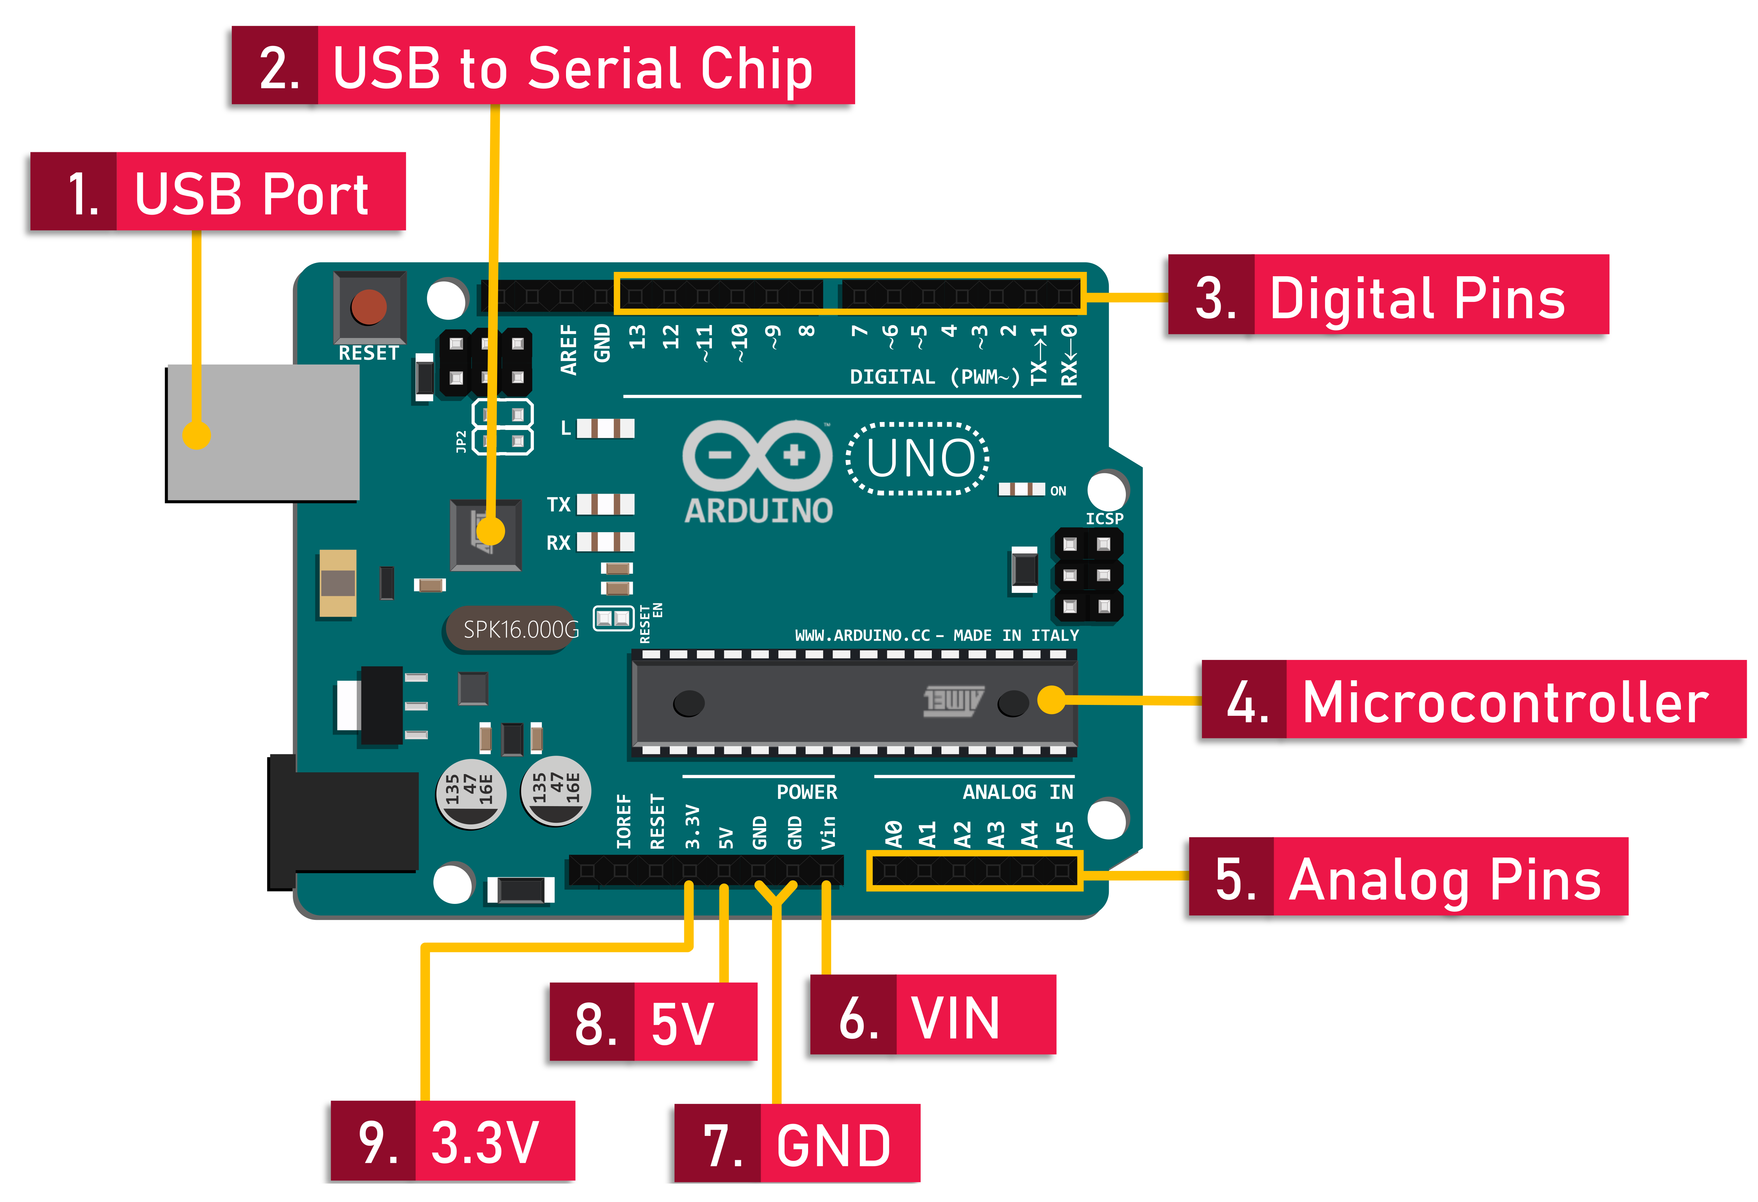
02
Embedded systems & Electronic parts
Arduino:
is an open-source electronics platform based on easy-to-use hardware and software.
Arduino uno anatomy

Slide 13
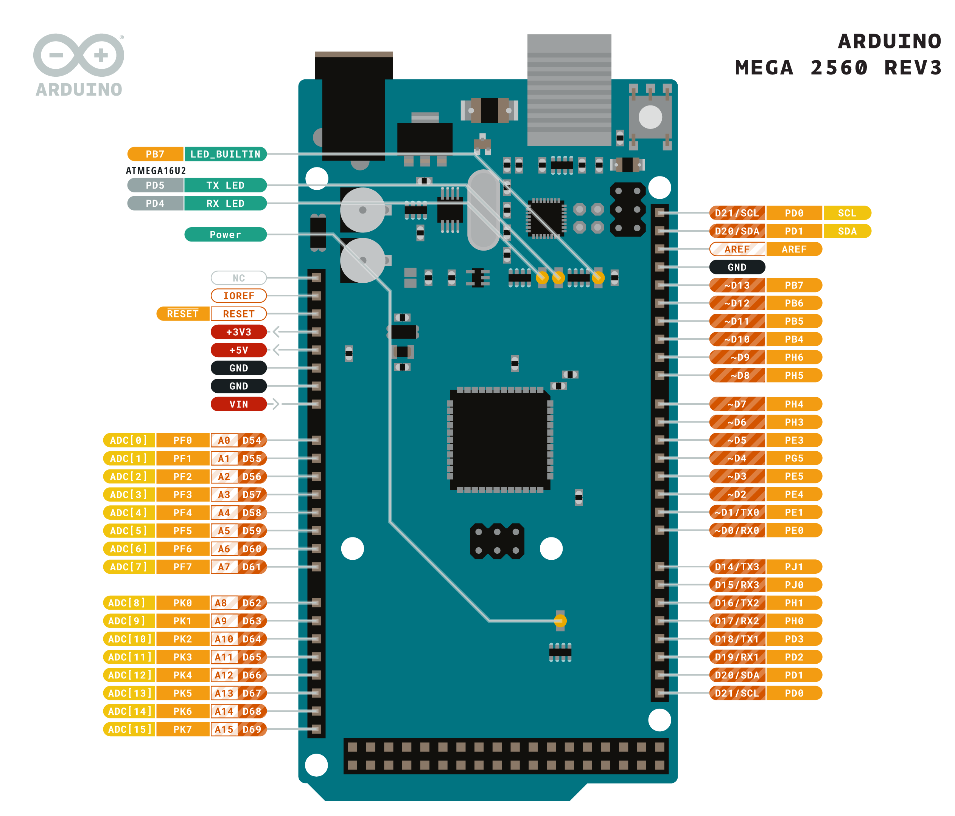
02
Embedded systems & Electronic parts
Arduino:
Arduino Mega anatomy

Slide 14
02
Embedded systems & Electronic parts
Sensors:
Sensors permit to extract information from the robot’s environment by measuring continuous physical properties.
Passive sensors
Exteroceptive sensors
Types of sensors
Active sensors
Proprioceptive sensors

Slide 15
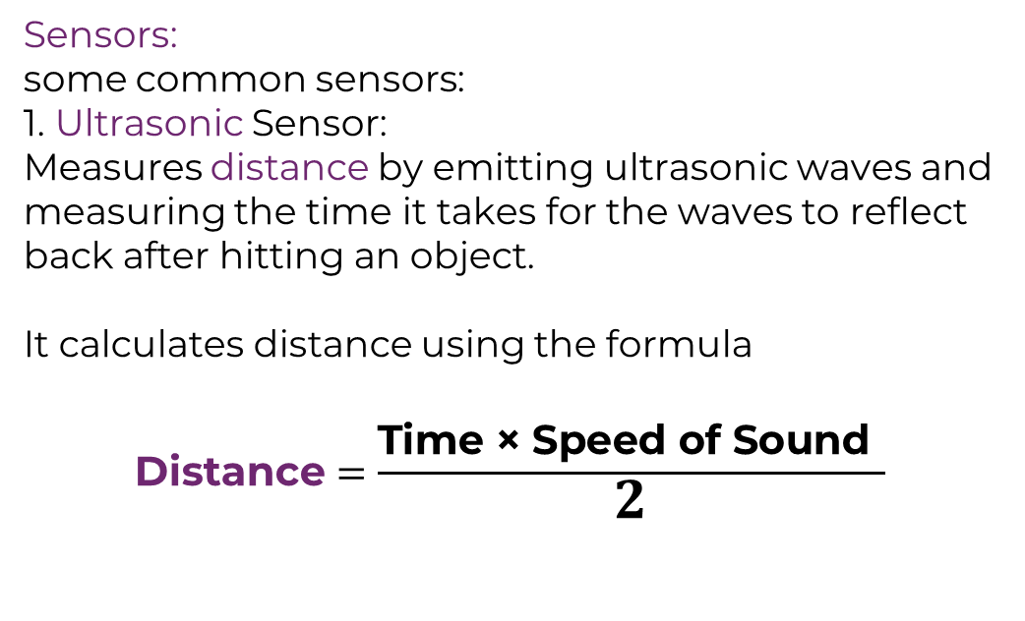
02
Embedded systems & Electronic parts
Sensors:
some common sensors:
1. Ultrasonic Sensor:
Measures distance by emitting ultrasonic waves and measuring the time it takes for the waves to reflect back after hitting an object.
It calculates distance using the formula
$$\text{Distance}=\frac{\text{Time} \text{×} \text{Speed} \text{of} \text{Sound}\text{​} }{2}$$

Slide 16
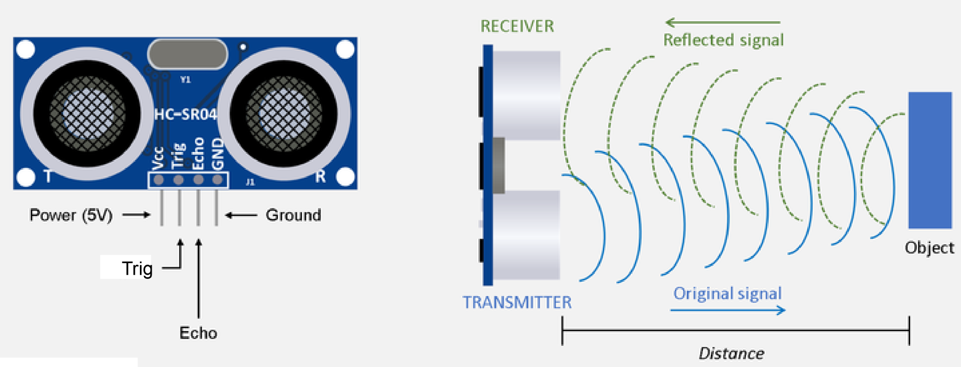
02
Embedded systems & Electronic parts
Sensors:
Ultrasonic Sensor anatomy
Active sensors

Slide 17
02
Embedded systems & Electronic parts
2. PIR (Passive Infrared) Sensor:
Detects infrared radiation (heat) emitted by objects in its field of view, especially from humans or animals.
When a warm body like a human passes in front of the sensor, it detects a sudden change in infrared radiation and triggers an output.

Slide 18
02
Embedded systems & Electronic parts
2. PIR (Passive Infrared) Sensor:
Detects infrared radiation (heat) emitted by objects in its field of view, especially from humans or animals.
When a warm body like a human passes in front of the sensor, it detects a sudden change in infrared radiation and triggers an output.

Slide 19
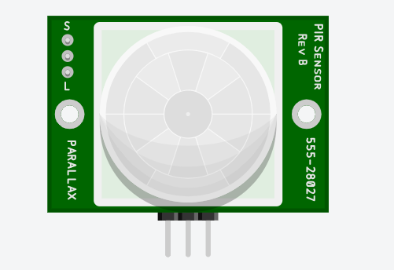
02
Embedded systems & Electronic parts
Sensors:
PIR Sensor anatomy
Passive sensors
signal
ground
power

Slide 20
02
Embedded systems & Electronic parts
Sensors:
3. Temperature Sensor : Measures temperature from its environment or object.
4. Smoke Sensor (MQ Series) : Detects the presence of smoke or gases such as carbon monoxide, methane, and LPG.
5. Laser Ranging Sensor (360° Omnidirectional Lidar) : Uses laser beams to measure the distance to surrounding objects in all directions, creating a 360° map of the environment.

Slide 21
02
Embedded systems & Electronic parts
Actuators:
Actuators enable the robots to move and eventually to modify their environment by converting stored energy into movements.
● The most widely used actuators are electric motors. They perform rotational movements that can be eventually converted into linear movements.
● Alternative options are constituted by hydraulic, pneumatic, or active material objects.

Slide 22
02
Embedded systems & Electronic parts
Actuators:
our workshop will focus on mobile robotics which is the most common type now a days.
Brushed
DC motors
Brushless
Types of Actuators
servo motors
Stepper
stepper motors

Slide 23
02
Embedded systems & Electronic parts
Actuators:
1. DC motors:
A simple DC motor that uses brushes and a commutator to transfer current to the rotor.
2. Brushless Motors:
A type of motor that eliminates brushes by using electronic controllers to drive the motor's rotation.

Slide 24
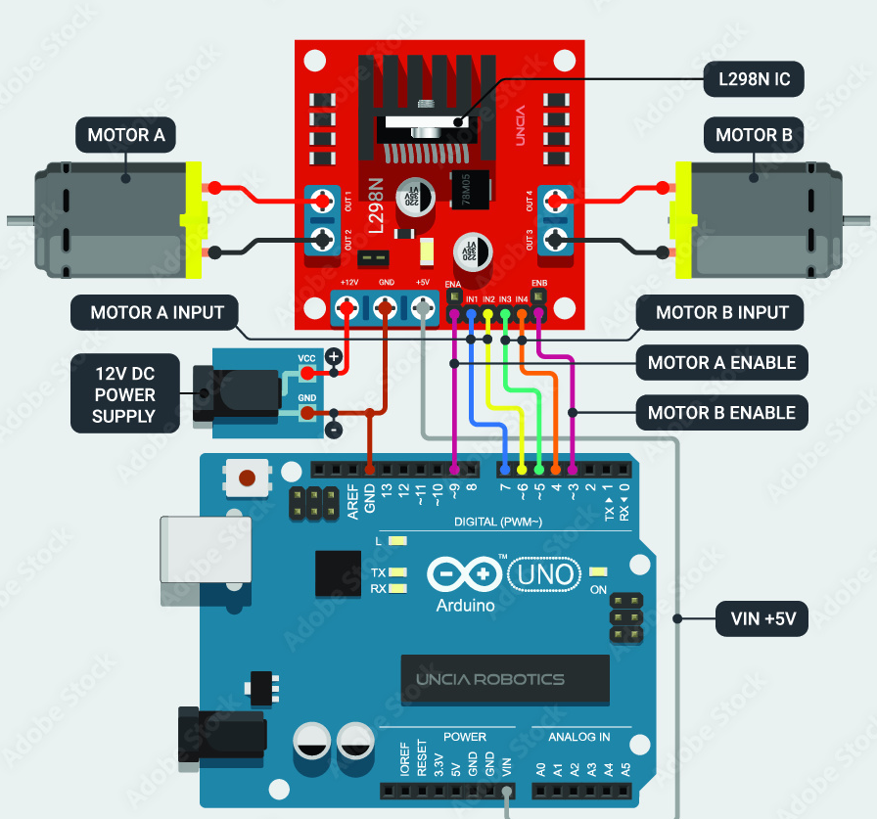
02
Embedded systems & Electronic parts
DC Motors & L298N DC Motor Driver

Slide 25
02
Embedded systems & Electronic parts
Actuators:
1. Stepper Motors:
Servo Motors : A closed-loop system where a motor is paired with a position sensor to provide accurate control over angular position, speed, and torque.
Stepper Motors : As mentioned, stepper motors rotate in distinct steps, making them suitable for applications requiring precise control over motion.

Slide 26
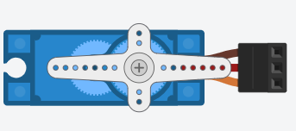
02
Embedded systems & Electronic parts
ground
power
signal
Servo motor anatomy

Slide 27
2.1
uncertainty
● To excel in the field of robotics, you need to be patient and not give up easily, as this field involves various disciplines. The more complex your project becomes, the more you'll need help from engineers in different fields. This is my opinion, so don't worry and take it easy.

Slide 28
2.2
Braitenberg Vehicles
● These vehicles are designed to demonstrate how complex behavior can emerge from very simple systems, and they serve as a thought experiment in understanding animal and human behavior through minimalistic robot design.
● No Processing Unit : Unlike most robots, Braitenberg vehicles typically do not have a microcontroller or any central processing unit (like an Arduino or Raspberry Pi).

Slide 29
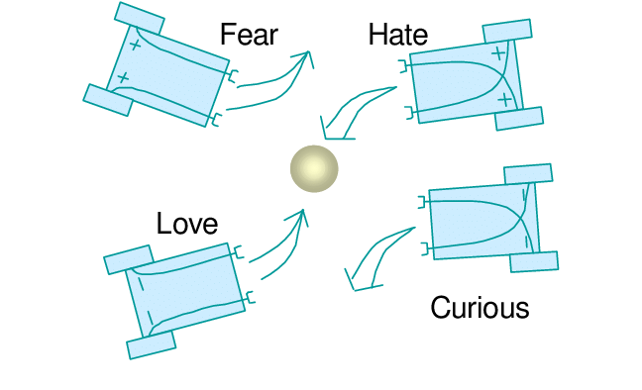
2.2
Braitenberg Vehicles

Slide 30





03
Programming
03
Programming

Slide 31
03
Programming
I would like to talk about c/c++ briefly in this workshop. But soon in the nearest future there will be a more in-depth and detailed workshop on Arduino programming.

Slide 32
04
Q&A Session.

Slide 33
Thanks
IEEE RAS BAU - Center
ras.ieee.bau
IEEE BAU Robotics and Automation Society - Center
BAU-RAS workshops manager: Mohammad Ismail

